Slide 1
Stock Market
Part 1 - Object Oriented Programming

Slide 2

But first…

Slide 3


Teaching Team Guest
Nick
TA

Slide 4





Teaching Team
Ben
Instructor
Seb
Instructor
Joseph
TA
Katia
TA
Sina
TA

Slide 5
Agenda
Problem Background
Learning Objectives
Coding

Slide 6
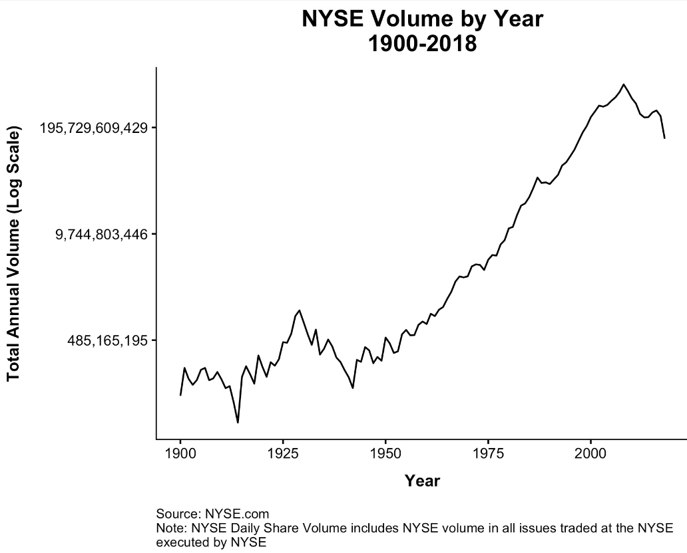
Software and the stock market
IBM computers started to appear at the New York Stock Exchange in the 1960s
Automation enabled the rate of trading to increase exponentially
Today, over $200 billion is traded daily on digital markets
Computers and automation begin

Slide 7

Background
Goal: Write a Python program using file I/O and object-oriented programming to analyze stock prices.

Slide 8
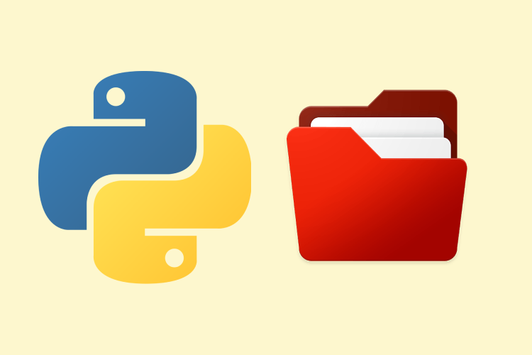
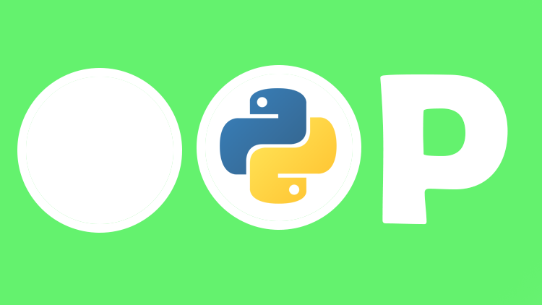
Learning Objectives
Practice opening and reading data from csv files
Practice writing and using custom classes

Slide 9
Engineering Design Process
Define the problem.
Define test cases.
Develop an algorithm plan (i.e. a workflow!).
Program your solution and debugging.

Slide 10
Some reminders.

Slide 11
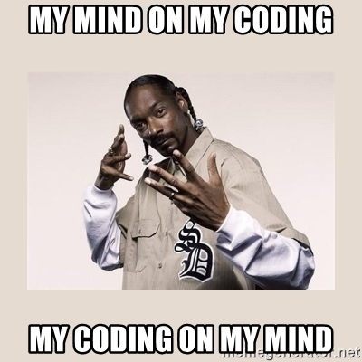
Example: Reading a CSV File (with)
Read each row of a CSV file using with
import csv
with open('grades.csv', 'r') as csvfile:
grades_reader = csv.reader(csvfile)
row_num = 1
for row in grades_reader:
print('Row #', row_num, ':', row)
row_num += 1
Row # 1 : ['Name', 'Test1', 'Test2', 'Final']
Row # 2 : [‘Kendrick', '100', '50', '29']
Row # 3 : [‘Dre', '76', '32', '33']
Row # 4 : [‘Snoop', '25', '75', '95']

Slide 12


Slide 13
Some more reminders.

Slide 14
Definition Recap
Class
Object
Instantiate
Method
Attribute
Constructor
self
Template for creating objects.
class Name:
def __init__(self, param1, param2, …):
self.param1 = param1
self.param2 = param2
…
body
def method1(self, parameters):
body
def method2(self, parameters):
body
def method3(self, parameters):
body

Slide 15

Definitions
class Turtle:
def __init__(self, x, y):
self.x = x
self.y = y
def up(self):
body
def goto(self, x, y):
body
def down(self):
body
Class
Object
Instantiate
Method
Attribute
Constructor
self
An instance of a class.
alex = Turtle(0, 0)
alex is an instance of the Turtle class.

Slide 16
Definition Recap
Class
Object
Instantiate
Method
Attribute
Constructor
self
Creating (constructing) an instance of a class.
alex = Turtle(0, 0)
This is the process of instantiating.

Slide 17
Definition Recap
Class
Object
Instantiate
Method
Attribute
Constructor
self
A function defined in a class.
def goto(x, y):
body
class Turtle:
def __init__(self, x, y):
self.x = x
self.y = y
def goto(self, x, y):
body
Function
Method

Slide 18
Definitions
class Turtle:
def __init__(self, x, y):
self.x = x
self.y = y
def up(self):
body
def goto(self, x, y):
body
def down():
body
Class
Object
Instantiate
Method
Attribute
Constructor
self
A variable bound to an instance of a class.
alex = Turtle(0, 0)
alex.x
alex.y
Attributes

Slide 19
Definitions
class Turtle:
def __init__(self, x, y):
self.x = x
self.y = y
def up(self):
body
def goto(self, x, y):
body
def down(self):
body
Class
Object
Instantiate
Method
Attribute
Constructor
self
Responsible for setting up the initial state of a new instance.
alex = Turtle(0, 0)
alex.x
alex.y
__init__ method is automatically run during instantiation.

Slide 20
Definitions
class Turtle:
def __init__(self, x, y):
self.x = x
self.y = y
def up(self):
body
def goto(self, x, y):
body
def down(self):
body
Class
Object
Instantiate
Method
Attribute
Constructor
self
Reference to the instance of the class.
Although you do not technically need to use the word self, it is widely adopted and is recommended.
Understanding self is a challenge for most students so don’t worry if you’re confused.

Slide 21

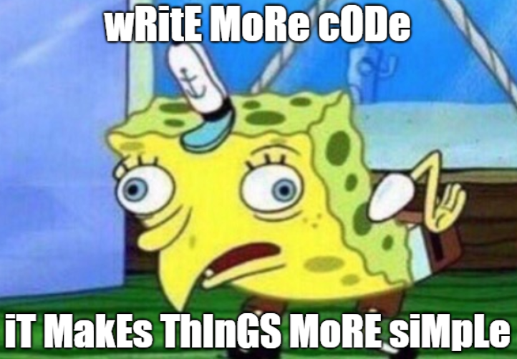
Recap: Why OOP?

Slide 22
Encapsulation
Encapsulation
y = up(y)
alex.up()
The core of object-oriented programming is the organization of the program by encapsulating related data and functions together in an object.
To encapsulate something means to enclose it in some kind of container.
In programming, encapsulation means keeping data and the code that uses it in one place and hiding the details of exactly how they work together.
Class
Attributes
Methods

Slide 23
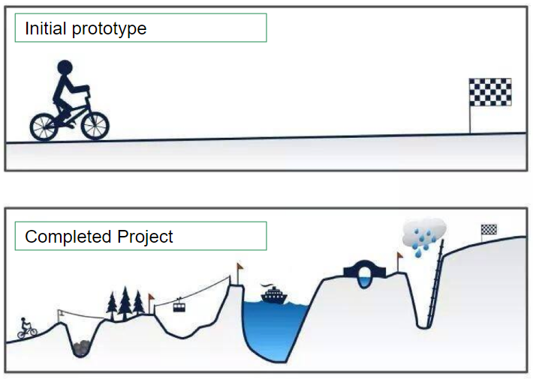
Recap: Why OOP?
“How would you do it?” -> “Translate this to Python” #cleancode
As programs get larger and more complex, it’s hard to represent everything as a list, dictionary, int, string, etc.
The solution is to create new data types (objects) that can store information (attributes) and define how they interact with other objects and itself (methods)

Slide 24

Preview: Tuesday
Same problem, but with pandas

Slide 25
Stock Market.

